Slide 1

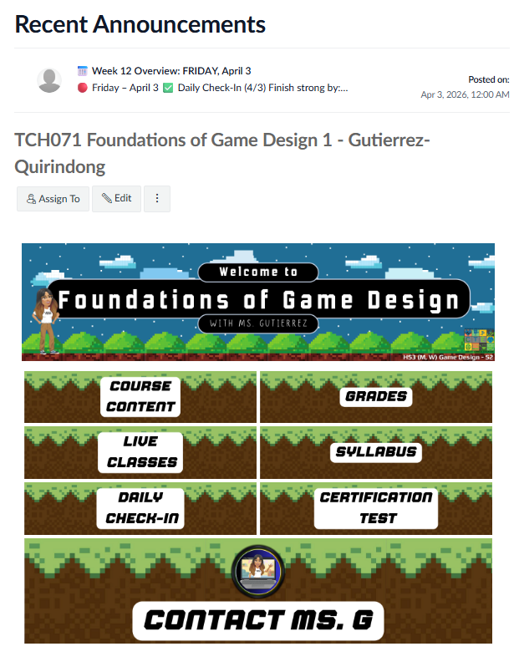
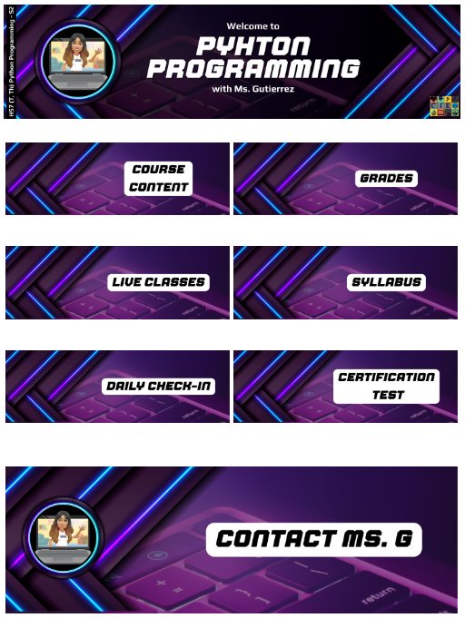
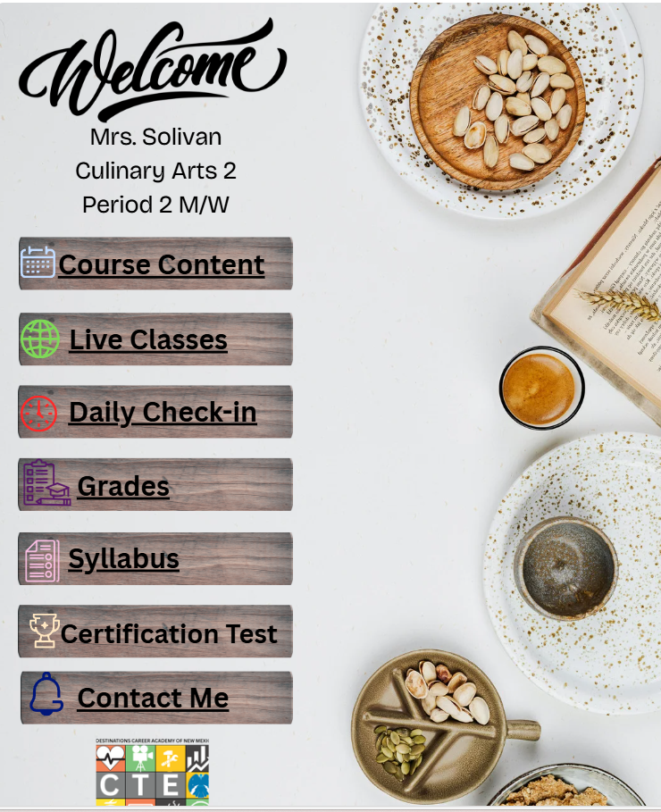
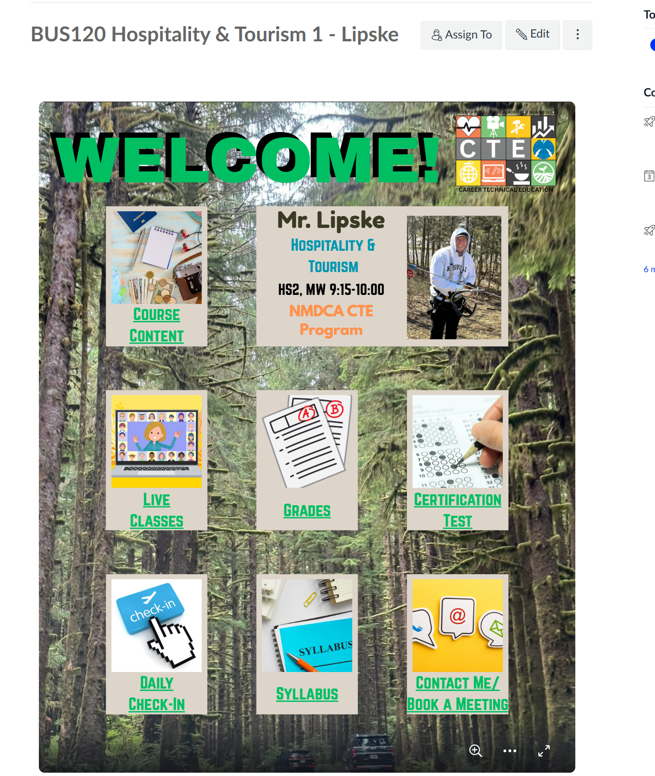
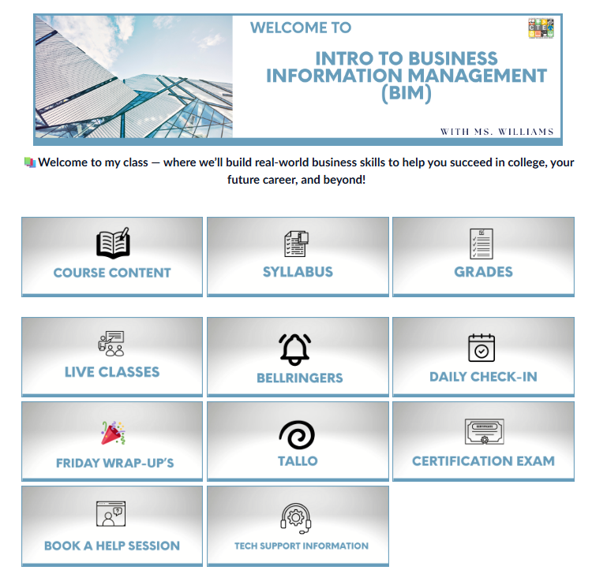
Drop Examples of:
A Simple & Clear Homepage

Slide 2
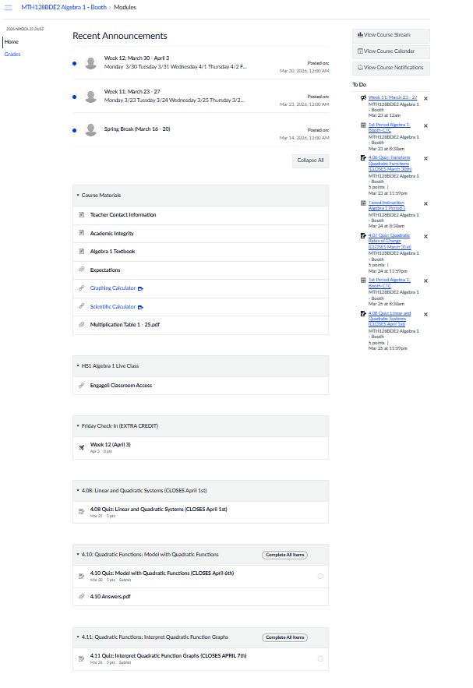
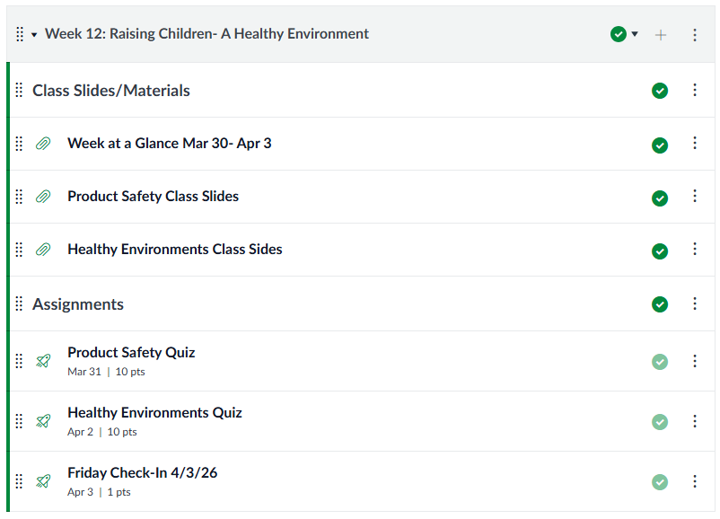
Drop Examples of:
A Simple & Clear Homepage
Basic, but it works!

Slide 3
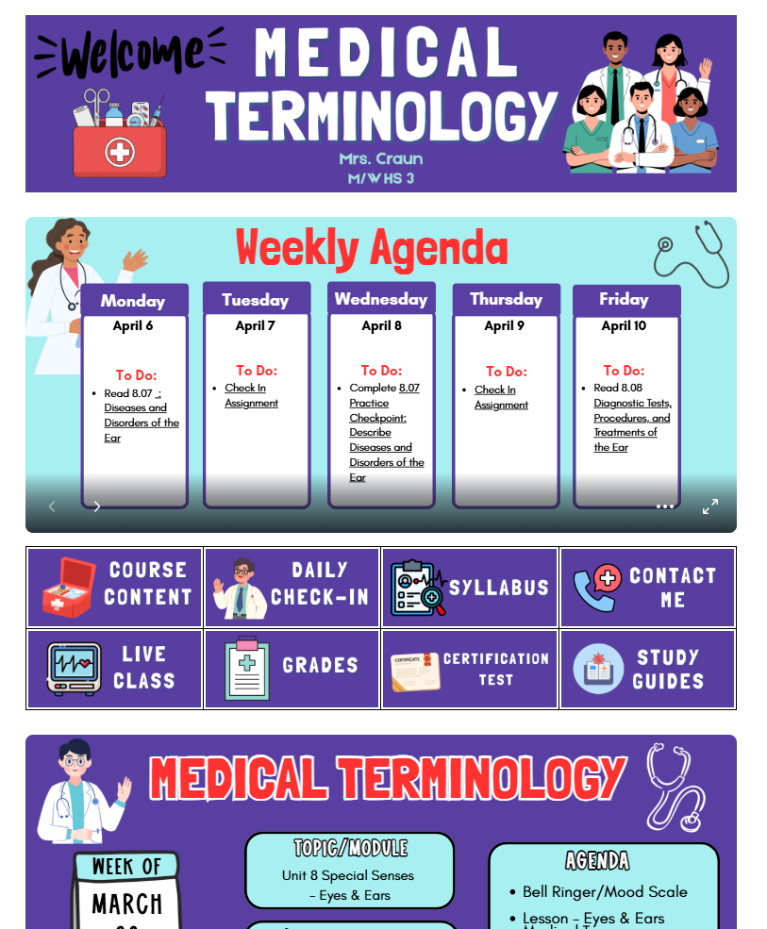

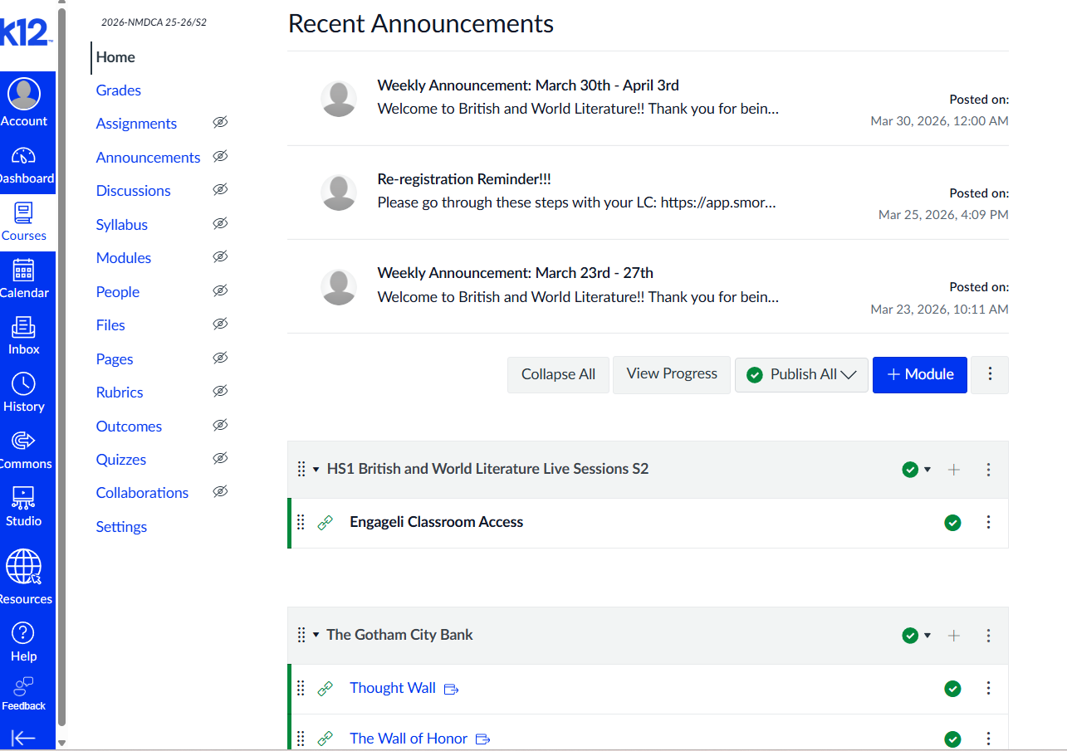
Drop Examples of:
A Simple & Clear Homepage

Slide 4
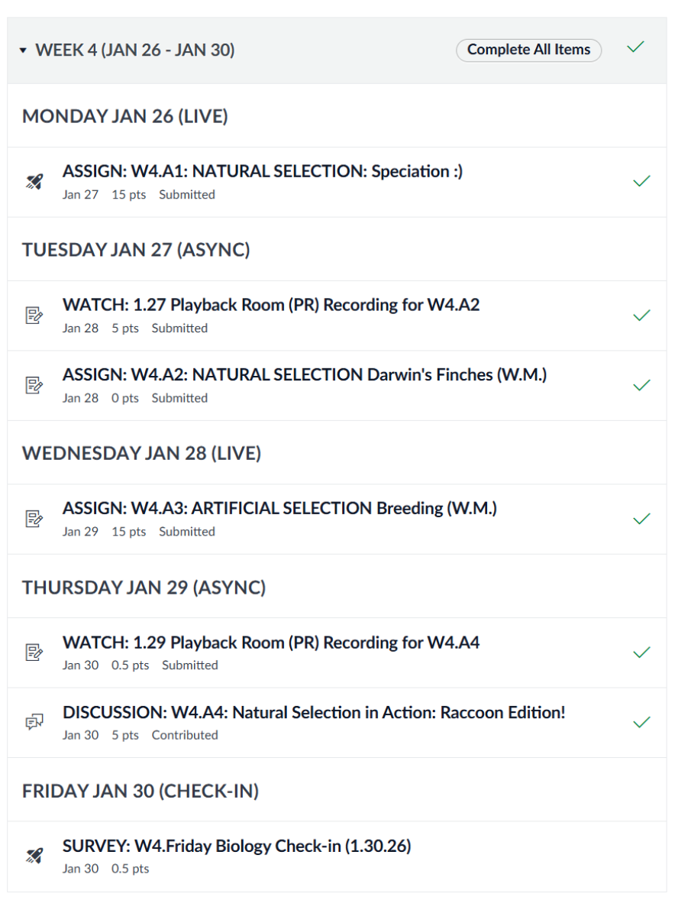
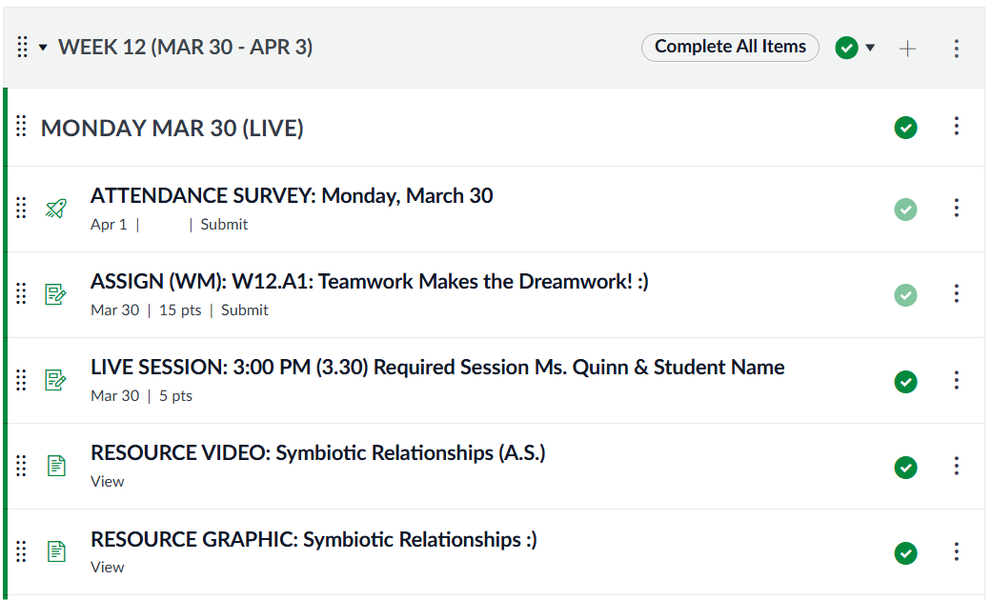
Drop Examples of:
A Simple & Clear Homepage
I put everything under modules – Even I:I's!! :)
Students will see all their "Biology To-Do List" on one page. Since it is only assigned to them, only those students will see it.
Note: It will not show in Student Observer mode if you use that mode to share screen with your classes. :)

Slide 5
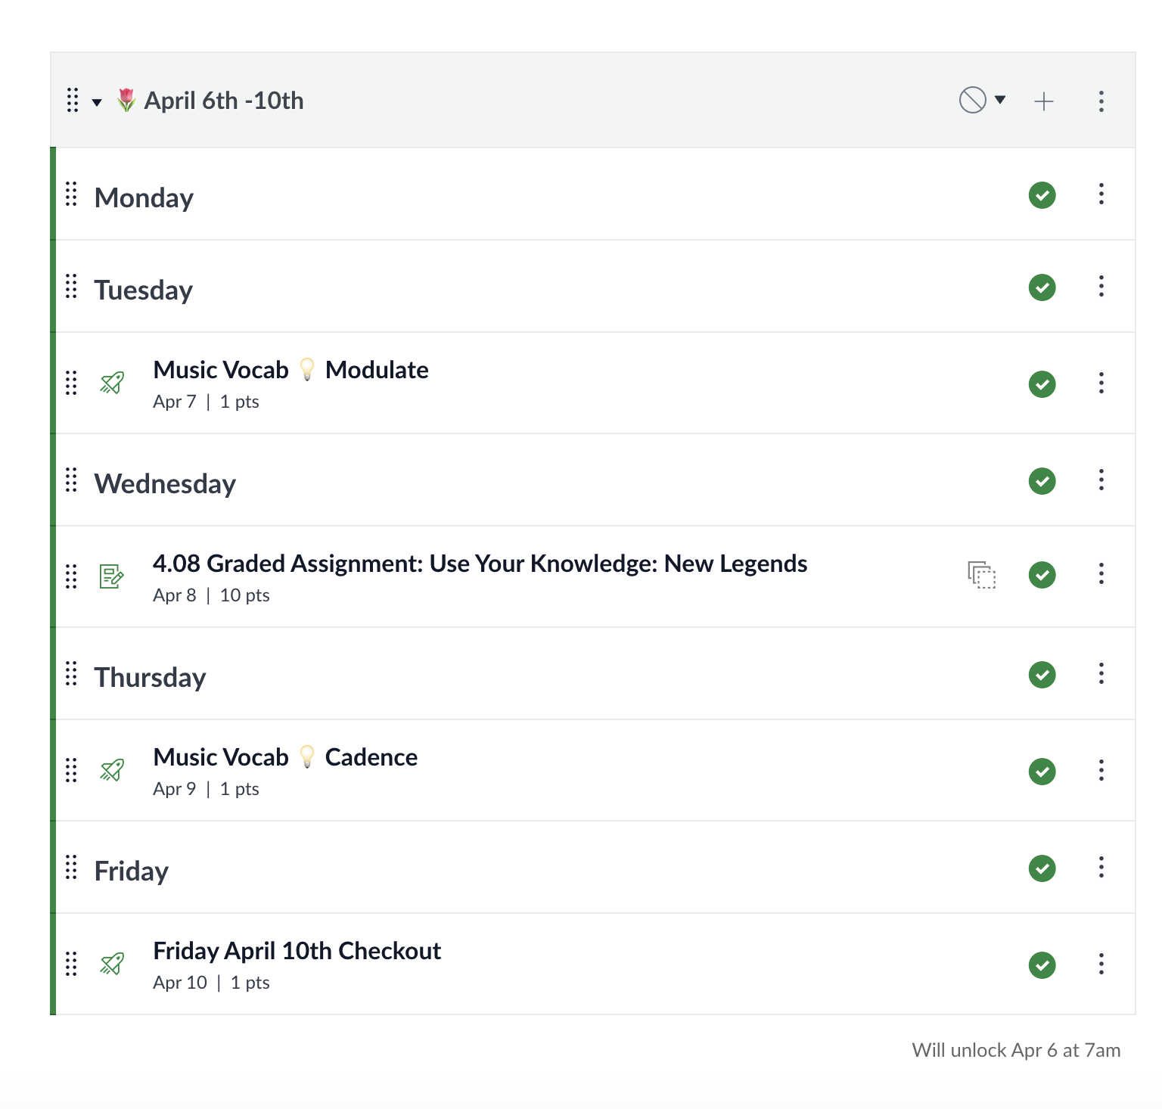
Drop Examples of:
A Simple & Clear Homepage
Not exciting yet, but easy to follow

Slide 6
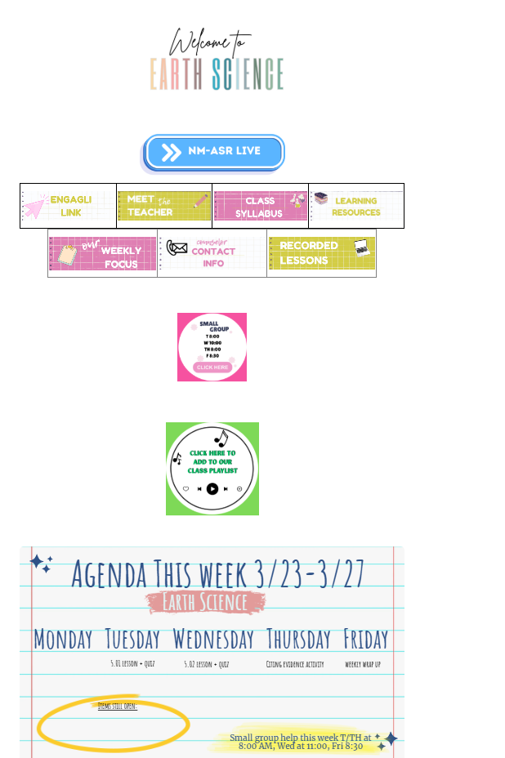

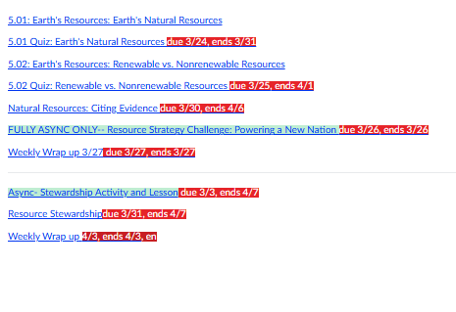
Drop Examples of:
A Simple & Clear Homepage
When they click on our weekly focus
homepage
In each unit- each assignment

Slide 7
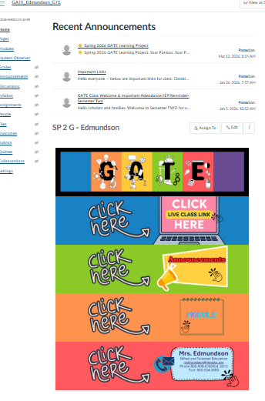
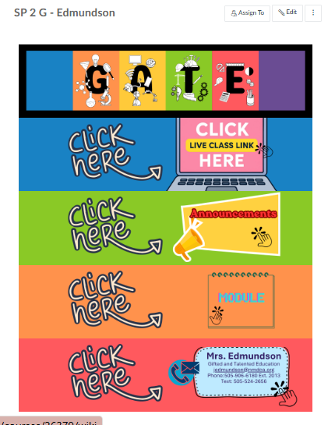
Drop Examples of:
A Simple & Clear Homepage

Slide 8
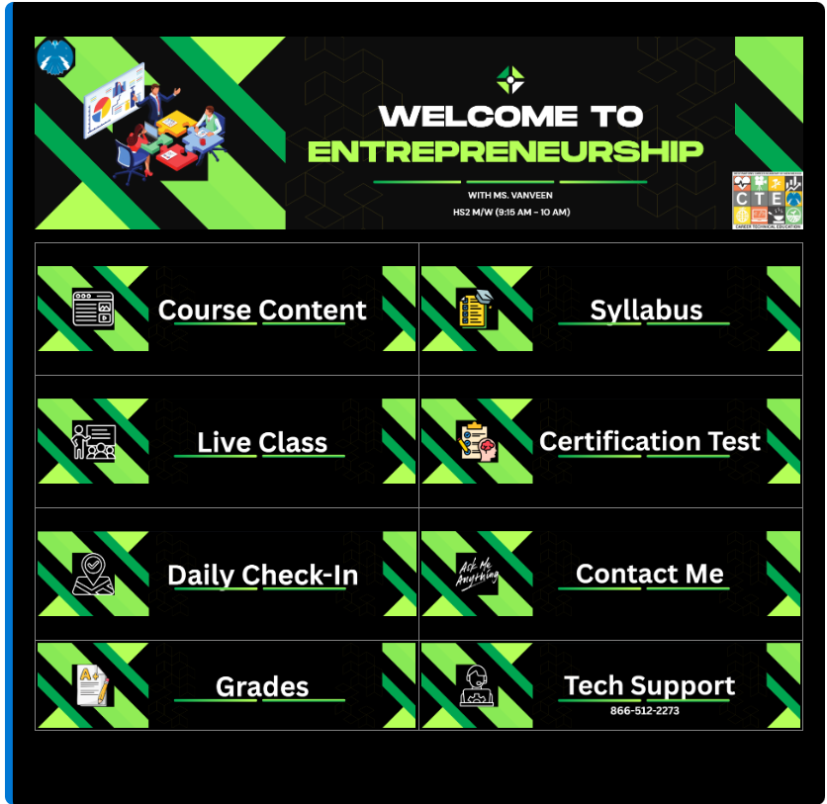
Drop Examples of:
A Simple & Clear Homepage

Slide 9
Drop Examples of:
A Simple & Clear Homepage

Slide 10
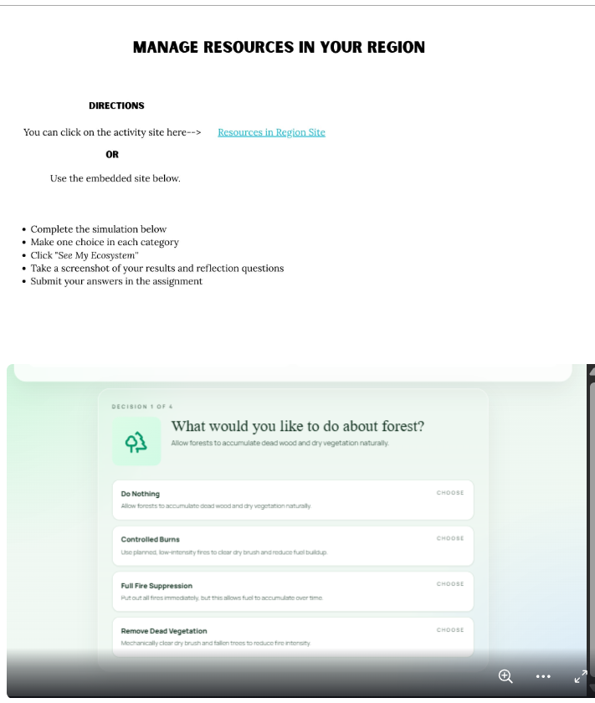
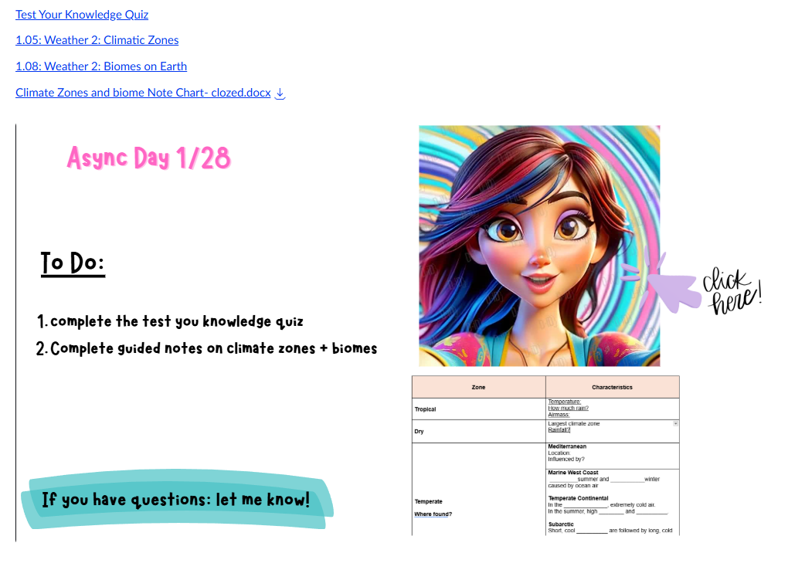
Drop Examples of:
Example of Instructions
To do list on a separate page- AI avatar giving instructions.
Screenshots of assignment look a likes
Hyperlinks to assignments
Embed instructions above activity in the instructions

Slide 11
Drop Examples of:
Example of Instructions

Slide 12
Drop Examples of:
Example of Instructions

Slide 13
Drop Examples of:
Example of Instructions

Slide 14
Drop Examples of:
Scaffolding Class Time

Slide 15
Drop Examples of:
Scaffolding Class Time

Slide 16
Drop Examples of:
Scaffolding Class Time

Slide 17
Drop Examples of:
Scaffolding Class Time

